Slide 1

Hospital Management SYstem
Moiz Ullah Khan CS-172061

Slide 2



Tech Requirements
Frontend
HTML,CSS, Bootstrap
Backend
Django
Database
Sqlite

Slide 3

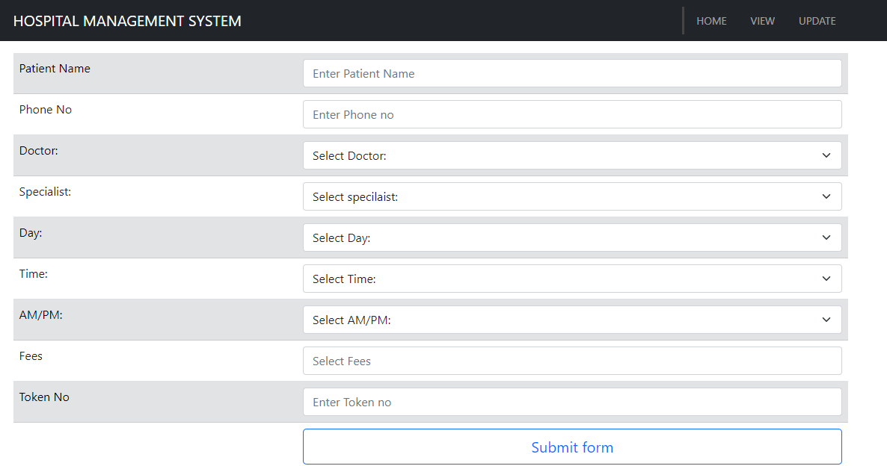
Home Page

Slide 4
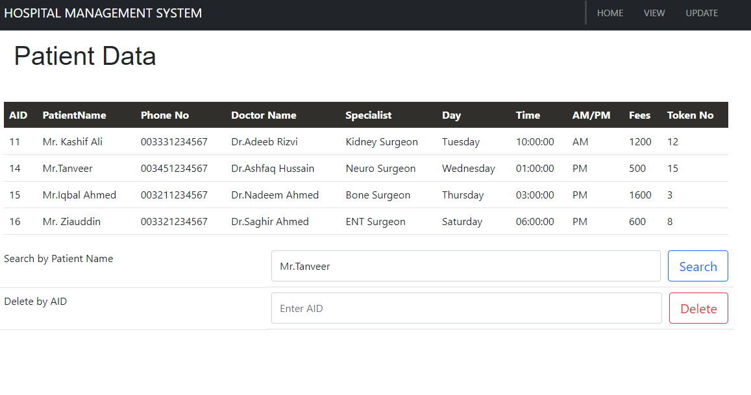
View Page

Slide 5
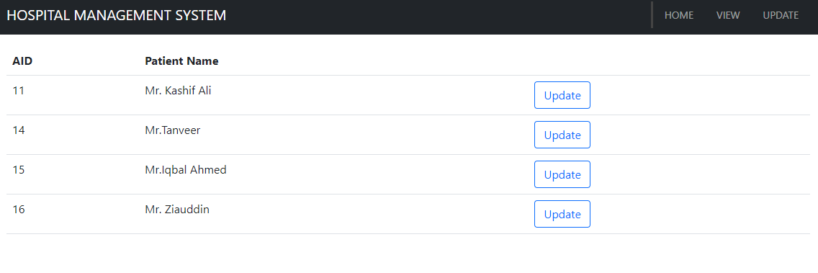
Update Page

Slide 6
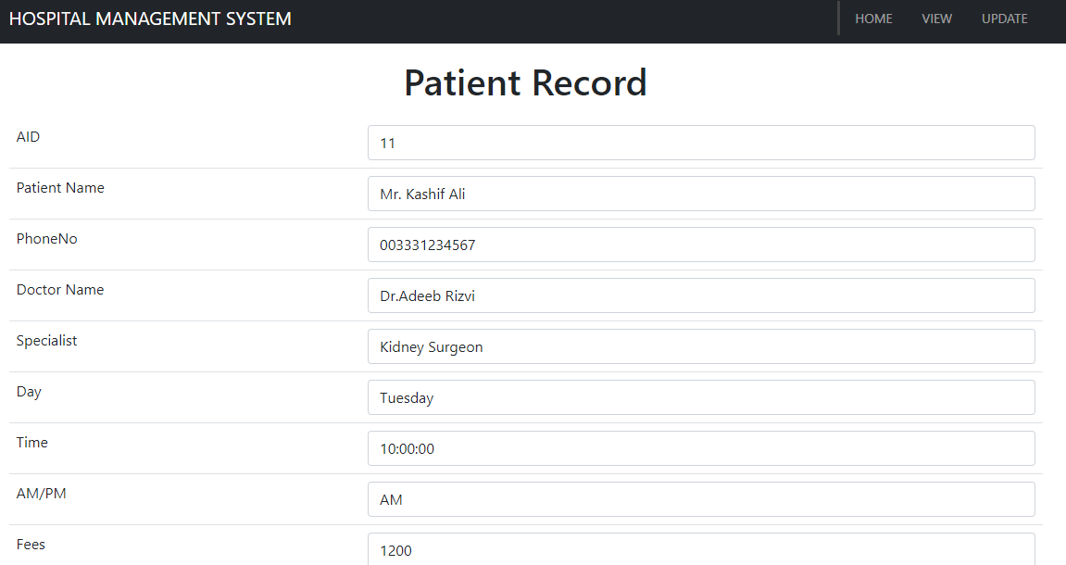
Update Page

Slide 7

Thank You

